Slide 1
Lecture 4.1
Testing Principles
Andy Aymeloglu - UATX Software Engineering

Slide 2
An exercise
What does this function do?
def foo(x: int, y: int, z: int) -> bool:
2, 4, 6 -> True
3, 6, 9 -> True

Slide 3
An exercise
What does this function do?
def foo(x: int, y: int, z: int) -> bool:
return True
2, 4, 6 -> True
3, 6, 9 -> True

Slide 4
How Do You Know Your Code Works?
Notes:
Deliberate opening question. Don't start with 'testing is important.' Start by asking students to reckon with what they did last week.

Slide 5
Last week, you shipped code
This week you’re writing api endpoints to talk to a database.
  GET /api/messages, POST /api/messages, DELETE /api/messages/{id}.

Slide 6
Last week, you shipped code
This week you’re writing api endpoints to talk to a database.
  GET /api/messages, POST /api/messages, DELETE /api/messages/{id}.
How do you know they actually worked?

Slide 7
Last week, you shipped code
This week you’re writing api endpoints to talk to a database.
  GET /api/messages, POST /api/messages, DELETE /api/messages/{id}.
How do you know they actually worked?
For most of you, the answer was something like:
  Start uvicorn
  Hit the endpoint with curl
  Eyeball the JSON
  "Yep, looks right."
Notes:
This has a name - manual verification

Slide 8
That's called manual verification
Manual verification. Running the code yourself and eyeballing the output to decide if it's right. Easiest form of testing.
Works fine for:
  Five lines of throwaway code
  A one-shot script you'll never touch again
  The very first time you write anything
Falls apart when:
  You have more than a few functions
  You plan to change the code later
  You want to sleep at night
Notes:
We're not attacking manual verification, we're attacking one specific, inadequate kind of testing.
Before we pick it apart, let's see what you'd naturally reach for.

Slide 9
A function you might see anywhere
def shipping_cost(weight_lb: float, subtotal: float) -> float:
"""Return the shipping cost for an order.
Flat rate of $5.99 for orders under 2 lb.
Add $2.50/lb for every pound over 2 lb.
Free shipping on orders with a subtotal of $50 or more.
"""
if subtotal >= 50.0:
return 0.0
base = 5.99
if weight_lb > 2.0:
base += 2.50 * (weight_lb - 2.0)
return round(base, 2)
Notes:
Show this, read it out loud, then put the discussion slide up. Don't explain it. Let students figure out what it's doing. The details they notice (edge cases, rounding, etc.) will come out in the discussion. This function is our running example for the whole pytest section, so leave it on the board mentally.

Slide 10
CONVINCE ME THIS IS CORRECT
def shipping_cost(weight_lb: float, subtotal: float) -> float:
"""Return the shipping cost for an order.
Flat rate of $5.99 for orders under 2 lb.
Add $2.50/lb for every pound over 2 lb.
Free shipping on orders with a subtotal of $50 or more.
"""
if subtotal >= 50.0:
return 0.0
base = 5.99
if weight_lb > 2.0:
base += 2.50 * (weight_lb - 2.0)
return round(base, 2)
Notes:
You will hear: (a) 'run it with some example inputs and check the output' - the manual verification baseline. (b) 'put print statements in' - variation on (a). (c) 'read it line by line' - code review. (d) 'ask someone else to look at it' - peer review. (e) maybe: 'try weird inputs, like negative weight' - edge case thinking. All valid, all manual. Leave the list on the board; we're about to pick it apart one item at a time.

Slide 11
Manual Verification Falls Apart
Notes:
Now we pick apart the strategies students just named. Every pain point should land on something from the board.

Slide 12
"It worked on my machine, one time, last Tuesday"
1. Doesn't repeat. Every change means redoing all the eyeballing.
  Nobody actually does this.
Notes:
Work through each point and tie it back to a strategy on the board. 'Run it with example inputs' fails #1 and #2. 'Read it line by line' fails #3 and #4. Etc. The critique is not that the strategies are wrong. It's that they don't compose.

Slide 13
"It worked on my machine, one time, last Tuesday"
1. Doesn't repeat. Every change means redoing all the eyeballing.
  Nobody actually does this.
2. Doesn't scale. Ten functions times three scenarios = thirty checks
Notes:
Work through each point and tie it back to a strategy on the board. 'Run it with example inputs' fails #1 and #2. 'Read it line by line' fails #3 and #4. Etc. The critique is not that the strategies are wrong. It's that they don't compose.

Slide 14
"It worked on my machine, one time, last Tuesday"
1. Doesn't repeat. Every change means redoing all the eyeballing.
  Nobody actually does this.
2. Doesn't scale. Ten functions times three scenarios = thirty checks
3. Doesn't remember. Change A, silently break C. Call it a regression.
  #1 source of bugs in existing software.
Notes:
Work through each point and tie it back to a strategy on the board. 'Run it with example inputs' fails #1 and #2. 'Read it line by line' fails #3 and #4. Etc. The critique is not that the strategies are wrong. It's that they don't compose.

Slide 15
"It worked on my machine, one time, last Tuesday"
1. Doesn't repeat. Every change means redoing all the eyeballing.
  Nobody actually does this.
2. Doesn't scale. Ten functions times three scenarios = thirty checks
3. Doesn't remember. Change A, silently break C. Call it a regression.
  #1 source of bugs in existing software.
4. Doesn't prove anything. "Looked right" is not "is right."
Notes:
Work through each point and tie it back to a strategy on the board. 'Run it with example inputs' fails #1 and #2. 'Read it line by line' fails #3 and #4. Etc. The critique is not that the strategies are wrong. It's that they don't compose.

Slide 16
"It worked on my machine, one time, last Tuesday"
1. Doesn't repeat. Every change means redoing all the eyeballing.
  Nobody actually does this.
2. Doesn't scale. Ten functions times three scenarios = thirty checks
3. Doesn't remember. Change A, silently break C. Call it a regression.
  #1 source of bugs in existing software.
4. Doesn't prove anything. "Looked right" is not "is right."
5. Doesn't survive people. The one person who knew how to check this function leaves.
Notes:
Work through each point and tie it back to a strategy on the board. 'Run it with example inputs' fails #1 and #2. 'Read it line by line' fails #3 and #4. Etc. The critique is not that the strategies are wrong. It's that they don't compose.

Slide 17
You can't hold a whole program in your head
Notes:
This is the frame for the rest of the lecture. Tests are not bureaucratic safety theater. They're the solution to the human brain being too small for modern software. If students buy this framing, everything else follows.

Slide 18
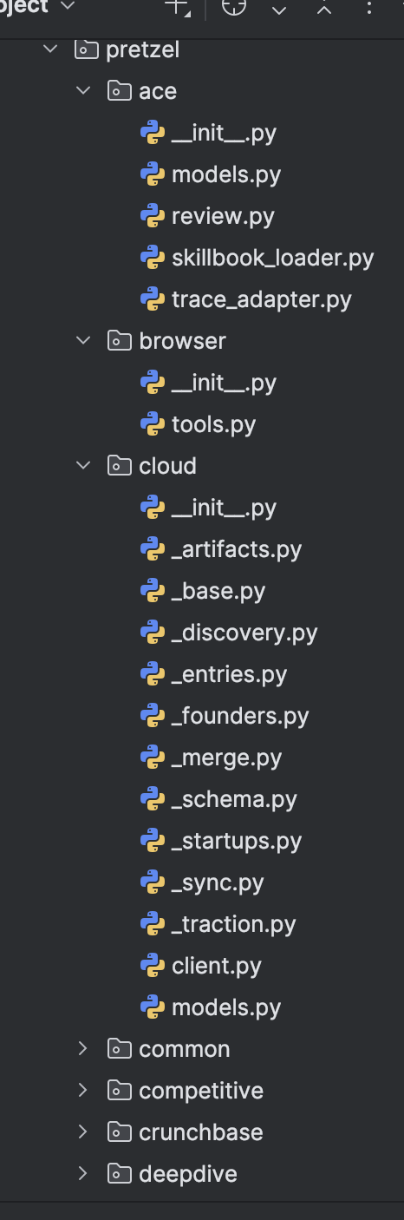
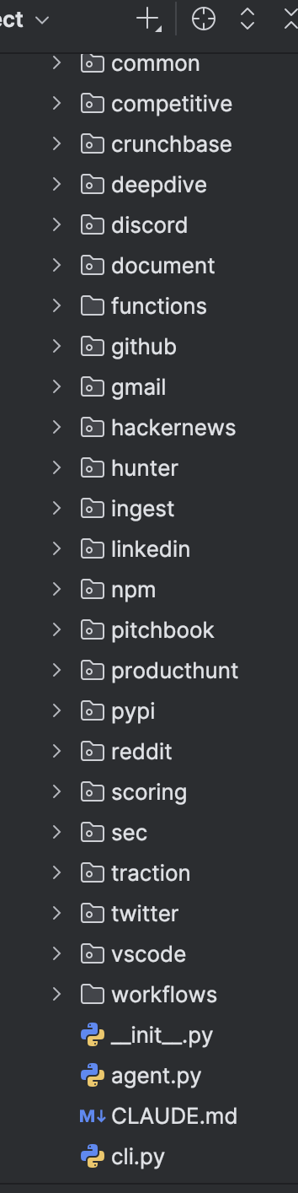
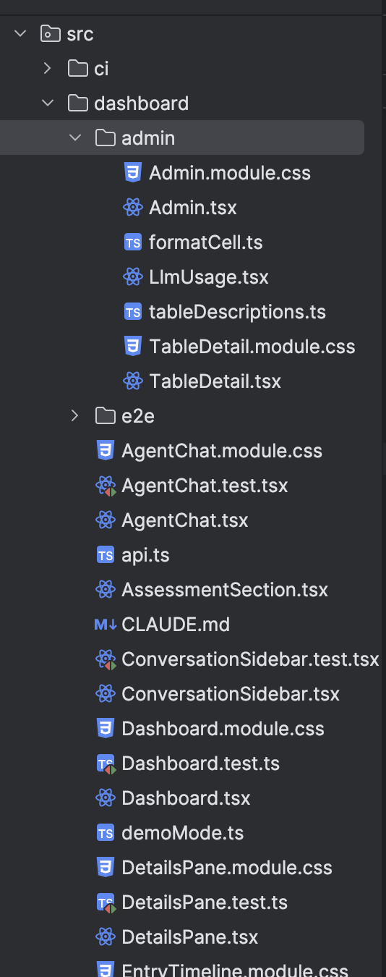
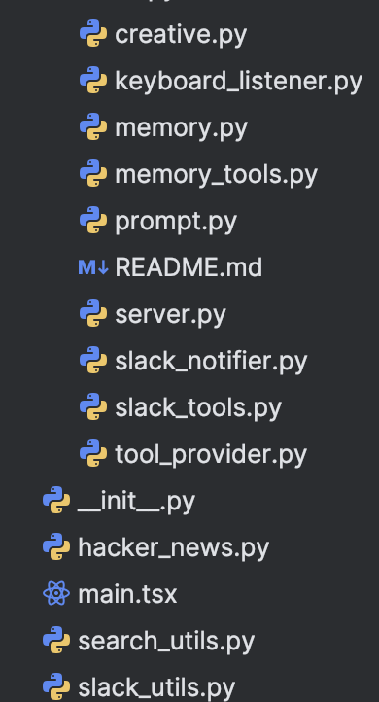
You can't hold a whole program in your head
Notes:
This is the frame for the rest of the lecture. Tests are not bureaucratic safety theater. They're the solution to the human brain being too small for modern software. If students buy this framing, everything else follows.

Slide 19
You can't hold a whole program in your head
Software grows past the size of a human brain. You physically can't track which parts still work after a change.
So you need something else that remembers for you:
  knows every case you've cared about,
  re-checks them all instantly on demand,
  speaks up the moment any of them breaks.
That something is a test: a function that describes expected
  behavior and fails loudly when the behavior changes.
Tests are executable memory.
Notes:
This is the frame for the rest of the lecture. Tests are not bureaucratic safety theater. They're the solution to the human brain being too small for modern software. If students buy this framing, everything else follows.

Slide 20
pytest Makes It Cheap
Notes:
Now the tool. Lighter than before: one framing slide, one conventions slide, a LIVE coding moment, and AAA. The live demo replaces three static slides from the old version.

Slide 21
You could write tests by hand. You won't.
Technically, you could write a test like this right now:
  result = shipping_cost(1.0, 10.0)
  if result != 5.99:
  print("BROKEN: got", result)
That works. Exactly once. Then you get bored and stop.
A testing framework gives you conventions, a runner that finds
  and executes all tests automatically, good error messages, and
  a standard report you can read at a glance.
In Python, the most popular framework is pytest.
  `pip install pytest`. No further setup.
Notes:
The point is friction. Anything that takes more than one line to write will not get written. pytest wins because its hello world is two lines of code and plain `assert`.

Slide 22
Three conventions and you're done
pytest has almost no API to learn. Just three rules:
  1. Test files are named `test_*.py` (or `*_test.py`).
  2. Test functions are named `test_*`.
  3. You write plain Python `assert`. No `assertEqual`, no
  `assertTrue`, no subclassing anything.
Running the whole suite is one command: `pytest`.
  Or `pytest -v` to see one line per test.
That's it. Now let’s write some.
Notes:
Deliberately short. Students don't need a read-along hello world because we're about to write one live. Land the three rules and move to the live slide.

Slide 23
?
Your turn: shout me test cases for shipping_cost.
I open test_shipping.py. You call out scenarios. I write the test, we run pytest. Then I break the function on purpose and we watch pytest catch it.
Notes:
THIS IS A LIVE CODING SLIDE. Suggested script: (1) Open an empty test_shipping.py next to shipping.py in the editor, projector up. (2) Ask the class: 'give me a scenario.' You will hear '1 pound, $10 subtotal' or similar. Type the test in real time: `def test_flat_rate_under_2_lb():\n assert shipping_cost(1.0, 10.0) == 5.99`. (3) Keep going until you have 3-4 tests covering: flat rate, over 2 lb surcharge, free shipping over $50, maybe exactly 2 lb or exactly $50 (edge cases). (4) Run `pytest -v` in the terminal. Watch it go green. Students see the per-test output live. (5) Comment out the `if subtotal >= 50.0: return 0.0` lines. Run pytest again. The free-shipping test fails with assertion introspection: `assert 5.99 == 0.0`. Point at the output. Say: 'that's assertion introspection. We never wrote an error message and it told us exactly what broke.' (6) Restore the function, tests green again, move on to AAA. Total time: 5-7 minutes.

Slide 24
A function you might see anywhere
def shipping_cost(weight_lb: float, subtotal: float) -> float:
"""Return the shipping cost for an order.
Flat rate of $5.99 for orders under 2 lb.
Add $2.50/lb for every pound over 2 lb.
Free shipping on orders with a subtotal of $50 or more.
"""
if subtotal >= 50.0:
return 0.0
base = 5.99
if weight_lb > 2.0:
base += 2.50 * (weight_lb - 2.0)
return round(base, 2)

Slide 25
Every test has three phases: Arrange, Act, Assert
Python
def test_shipping_surcharge_over_2_lb():
# Arrange - set up the inputs
weight = 5.0
subtotal = 10.00
# Act - call the function under test, once
cost = shipping_cost(weight, subtotal)
# Assert - check the result
assert cost == 13.49 # 5.99 + 2.50 * (5.0 - 2.0)
# Separate the three phases with blank lines. Every test in the
# codebase ends up with the same shape, so reading an unfamiliar
# test takes ten seconds instead of a minute.
#
# AAA is a habit, not a framework feature
Notes:
Combine the old AAA concept slide and AAA code slide into one. The same shipping_cost function from the live demo, now cleanly formatted. Point at each comment and name the phase. Blank lines between phases make the structure pop visually. Tell students: if you take one habit from this lecture, make it this one. It costs nothing and compounds forever.

Slide 26
Which of these is better?
Python
# ------ Version A ------
def test_shipping():
assert shipping_cost(1.0, 10.0) == 5.99
assert shipping_cost(5.0, 10.0) == 13.49
assert shipping_cost(1.0, 75.0) == 0.0
# ------ Version B ------
def test_flat_rate_under_2_lb():
assert shipping_cost(1.0, 10.0) == 5.99
def test_surcharge_over_2_lb():
assert shipping_cost(5.0, 10.0) == 13.49
def test_free_shipping_over_50():
assert shipping_cost(1.0, 75.0) == 0.0
Notes:
# Both check the same three things. Which would you rather debug
# at 11pm when something broke in production?
DISCUSSION SLIDE. Give the class 30 seconds to read, then cold-call. Expect: 'Version B, because when it fails you know which scenario broke.' Press on it. What else? (a) The names in B are documentation - anyone reading the test file learns the shipping rules by reading test names. (b) In A, if the first assert fails, the second and third never run. You might have three bugs and only see one. (c) B is easier to add a fourth test to - you just add another function. In A you're editing one big one. Draw out these points from students rather than listing them. This discussion sets up the properties slide perfectly.

Slide 27
What makes a test good
One behavior per test. A test that checks three things is three tests crammed into one
A name that reads like a sentence.
  test_free_shipping_over_50 beats test_shipping_3
Obvious on failure. You should know what broke without a debugger.
Deterministic. Same inputs, same result. No randomness, clocks, or network (yet)
Fast. Slow tests don't get run.
Independent. Passes or fails the same alone or in any order.
Notes:
Most of these came out of the last discussion. Go quickly; students have already internalized the first two. Spend the most time on deterministic and independent, which are newer to them and will come up in 4.2 when we talk about databases and fixtures.

Slide 28
Testing that code raises on bad input
Python
# price_utils.py
def parse_price(s: str) -> float:
"""Parse a price string like '$19.99' into a float."""
if not s.startswith("$"):
raise ValueError(f"price must start with $, got: {s!r}")
return float(s[1:])
Notes:
pytest.raises is how you test that something SHOULD raise. Without it, the exception would propagate out of the test and fail it. With it, the test passes when the exception fires and fails when it doesn't. The match= argument lets you check the error message too. Short slide; this is the only new pytest mechanic in the lecture.

Slide 29
Testing that code raises on bad input
Python
# price_utils.py
def parse_price(s: str) -> float:
"""Parse a price string like '$19.99' into a float."""
if not s.startswith("$"):
raise ValueError(f"price must start with $, got: {s!r}")
return float(s[1:])
# test_price_utils.py
def test_parses_a_normal_price():
assert parse_price("$19.99") == 19.99
def test_rejects_a_price_without_dollar_sign():
with pytest.raises(ValueError):
parse_price("19.99")
def test_error_message_mentions_the_bad_input():
with pytest.raises(ValueError, match="19.99"):
parse_price("19.99")
Notes:
pytest.raises is how you test that something SHOULD raise. Without it, the exception would propagate out of the test and fail it. With it, the test passes when the exception fires and fails when it doesn't. The match= argument lets you check the error message too. Short slide; this is the only new pytest mechanic in the lecture.

Slide 30
Which of these tests is worth writing? (pick any)
Python
# Option A
def test_python_addition_works():
assert 2 + 2 == 4
# Option B
def test_sqlite_can_store_a_row():
conn = sqlite3.connect(":memory:")
conn.execute("CREATE TABLE t (x INT)")
conn.execute("INSERT INTO t VALUES (1)")
assert conn.execute("SELECT x FROM t").fetchone() == (1,)
# Option C
def test_create_message_endpoint_stores_the_message():
response = client.post("/api/messages", json={"text": "hi"})
assert response.status_code == 201
assert db.query("SELECT text FROM messages").fetchone() == ("hi",)
# Option D
def test_shipping_cost_gives_free_shipping_over_50():
assert shipping_cost(1.0, 75.0) == 0.0
Notes:
DISCUSSION SLIDE. Give the class a minute to read, then ask them to raise hands for each option. Expect most of the class to correctly pick C and D. Work through the wrong ones: A tests PYTHON. Python is tested thousands of times by other people. You are not going to find a bug in `+`. B tests SQLITE. Same problem. The sqlite team has this covered. If you need a sanity check that sqlite works, you have bigger problems. C tests YOUR endpoint end-to-end - valuable. D tests YOUR shipping_cost with a real business rule (the free-shipping threshold) - valuable. The general rule: test the behavior YOU wrote. Not that `int` can add or FastAPI can FastAPI or sqlite can sqlite. This is the single most common way beginners waste time on tests - hundreds of assertions that are all 'yes, Python is Python.'

Slide 31
Tests Are a Design Tool
Notes:
Everything so far has been 'tests are executable memory.' Now: tests are also a design tool, and that might be the more important benefit.
If you’ve seen Superpowers, you may have seen “test-driven development”

Slide 32
Try writing the test first
Until now, the implicit order has been:
  1. Write the function -> 2. Write some tests
Notes:
The trick is to make students notice that they're already doing design work when they write a test. They just usually do it AFTER they've already made the decisions. TDD is just moving that work earlier so it can actually influence the code.

Slide 33
Try writing the test first
Until now, the implicit order has been:
  1. Write the function -> 2. Write some tests
Flip it:
  1. Write the test -> 2. Write the function that passes it
Notes:
The trick is to make students notice that they're already doing design work when they write a test. They just usually do it AFTER they've already made the decisions. TDD is just moving that work earlier so it can actually influence the code.

Slide 34
Try writing the test first
This sounds backwards. You can't test a function that doesn't exist.
  But you also can't write the test without deciding what the function
  is called, what it takes, what it returns, and what 'correct' means.
Those are design decisions. Writing the test first forces you to make them before you write any implementation code.
This practice has a name: Test-Driven Development (TDD).
Notes:
The trick is to make students notice that they're already doing design work when they write a test. They just usually do it AFTER they've already made the decisions. TDD is just moving that work earlier so it can actually influence the code.

Slide 35
Why writing the test first works
When you write a test for a function that doesn't exist yet,
  you become the first user of that function.
You have to answer, before writing any code:
  What is it called?
  What does it take and return?
  What happens on weird input? (empty? zero? negative?)
  How do I want to call it from the outside?
These are the questions your teammate or PR reviewer will ask later.
  Answering them first means the code they find is already designed.
The safety net is the second benefit of TDD. The design pressure
  is the first.
Notes:
This is the insight most students won't have heard before. TDD isn't about test coverage or catching bugs. Those are downstream effects. It's about being forced to make design decisions at the moment when they're cheapest to change.

Slide 36
Red, Green, Refactor
The TDD loop has three steps. Each one takes a minute or two.
  RED. Write a small test for behavior that doesn't exist yet.
  Run it. Watch it fail with a clear error.
  GREEN. Write the simplest code that makes the test pass.
  Run pytest. Watch it go green.
  REFACTOR. Clean up. Rename, extract, simplify. Re-run tests.
Then pick the next behavior and go around again.
Notes:
Don't oversell TDD as a panacea. Some code is hard to test first (UI, exploratory prototypes). For a function like shipping_cost or format_file_size, it is almost always worth trying.
Not a religion, not always right. But more often the right tool than you'd think, especially for pure functions.

Slide 37
TRY IT
Write tests for a function that doesn't exist yet
# GOAL: we're going to write format_file_size(n: int) -> str,
# which turns a byte count into a human-readable string:
#
# format_file_size(500) -> "500 B"
# format_file_size(1024) -> "1.0 KB"
# format_file_size(1_500_000) -> "1.4 MB" (roughly)
#
# We have NOT written it yet.
# Write the tests first. Then we'll make them pass.
import pytest
from file_utils import format_file_size
def test_zero_bytes():
def test_small_number_of_bytes():
def test_exactly_one_kilobyte():
def test_megabyte_range():
def test_gigabyte_range():
Notes:
The exercise is partly about the answers and partly about noticing that you can't fill in the blanks without making design decisions: should 1024 be '1 KB' or '1.0 KB'? Should 0 be '0 B' or '0 bytes' or '0'? There are no wrong answers, only decisions.

Slide 38
TRY IT
Write tests for a function that doesn't exist yet
# GOAL: we're going to write format_file_size(n: int) -> str,
# which turns a byte count into a human-readable string:
#
# format_file_size(500) -> "500 B"
# format_file_size(1024) -> "1.0 KB"
# format_file_size(1_500_000) -> "1.4 MB" (roughly)
#
# We have NOT written it yet.
# Write the tests first. Then we'll make them pass.
Notes:
The exercise is partly about the answers and partly about noticing that you can't fill in the blanks without making design decisions: should 1024 be '1 KB' or '1.0 KB'? Should 0 be '0 B' or '0 bytes' or '0'? There are no wrong answers, only decisions.

Slide 39
ANSWER
Write tests first, then implement
# test_file_utils.py - tests we wrote BEFORE the implementation
def test_zero_bytes(): assert format_file_size(0) == "0 B"
def test_small_number_of_bytes(): assert format_file_size(500) == "500 B"
def test_exactly_one_kilobyte(): assert format_file_size(1024) == "1.0 KB"
def test_megabyte_range(): assert format_file_size(1024 ** 2) == "1.0 MB"
def test_gigabyte_range(): assert format_file_size(1024 ** 3) == "1.0 GB"
# file_utils.py - the implementation that falls out of the tests
def format_file_size(n: int) -> str:
if n < 1024:
return f"{n} B"
for unit in ["KB", "MB", "GB", "TB"]:
n /= 1024
if n < 1024:
return f"{n:.1f} {unit}"
return f"{n:.1f} PB"
Notes:
Walk through the implementation and point at each line where a test pinned down a decision. The integer-vs-float formatting is the cleanest example: test_small_number_of_bytes forced us to use no decimals for bytes, while test_exactly_one_kilobyte forced us to use one decimal for everything else. We didn't decide that separately. The tests made us commit before we wrote any code.

Slide 40
Where this goes next
So far:
  Tests are executable memory. Your brain can't hold a whole
  program; let the machine remember which cases still work.
  Tests are a design tool. Writing the test first forces you to
  be the first user of your own code, before the API is cement.
Next: practical testing. How to test a function
  that talks to a database, how to test FastAPI endpoints without
  starting a real server, fixtures, setup and teardown, keeping
  tests fast and independent.
Notes:
Summary of the two insights, then forward reference. Assignment 2 will have testing requirements starting at bronze tier, so students need to take 4.2 seriously.

Slide 41
Your New Problem
Notes:
4.1 taught the fundamentals on pure functions. Now reality hits.

Slide 42
What we saw was the easy case
So we’ve learned to test functions like these:
  shipping_cost(weight_lb, subtotal) -> float
  format_file_size(n) -> str
  parse_price(s) -> float
These were easy to test:
  No extraneous systems.
  Same input, same output, every time.
  One call, one return value, one assertion.
API endpoints aren’t like that.
Notes:
Set up the contrast between pure functions (easy) and the real code students wrote last week (hard). Don't explain why yet - make them see it on the next slide.

Slide 43
The chat endpoint has dependencies everywhere
Look at one line: `POST /api/messages` in your FastAPI app.
Under the hood, it depends on:
  A SQLite database (your chat.db file, with real data)
  The wall clock (for the timestamp via datetime.utcnow)
  FastAPI itself (request parsing, Pydantic validation)
  A TCP port that uvicorn has to be listening on
  The filesystem (to open chat.db)
To test this endpoint, you'd think you’d need a server, db, port, and clock.
Notes:
Every item on the list becomes a mini-section of this lecture. The phrase 'control the world around your code' is the central insight. Keep pointing back to it.
The trick of practical testing is one phrase:
control the world around your code.

Slide 44
A test that tries to use all the real things
Python
# test_chat_bad.py - don't write tests like this
import subprocess, time, requests
def test_post_message():
# Start a real server in a subprocess
proc = subprocess.Popen(["uvicorn", "app:app"])
time.sleep(2) # wait for it to come up (hopefully)
try:
r = requests.post(
"http://localhost:8000/api/messages",
json={"author": "alice", "text": "hi"},
)
assert r.status_code == 201
assert r.json()["author"] == "alice"
finally:
proc.terminate()
Notes:
This test works. Technically. It spins up the real uvicorn, hits the real endpoint, and checks the real response. Every dependency is real - which is exactly the problem. Read it out loud line by line before the discussion slide.

Slide 45
What makes a test good
One behavior per test. A test that checks three things is three tests crammed into one
A name that reads like a sentence.
  test_free_shipping_over_50 beats test_shipping_3
Obvious on failure. You should know what broke without a debugger.
Deterministic. Same inputs, same result. No randomness, clocks, or network (yet)
Fast. Slow tests don't get run.
Independent. Passes or fails the same alone or in any order.
Notes:
Most of these came out of the last discussion. Go quickly; students have already internalized the first two. Spend the most time on deterministic and independent, which are newer to them and will come up in 4.2 when we talk about databases and fixtures.

